Slide 1



GreenRoute AI
The navigation app that picks the route with the lowest carbon footprint
Innovation project: fighting global warming and protecting the ozone layer

Slide 2
Agenda
01
The challenge
02
The idea
03
The technology
04
The business
05
The impact
06
The roadmap

Slide 3



Transport and the climate
~25%
~75%
Every trip
of global energy-related CO₂ comes from transport
of transport emissions come from road vehicles
burns fuel that could be saved with a smarter route
Figures are approximate global estimates (IEA).

Slide 4
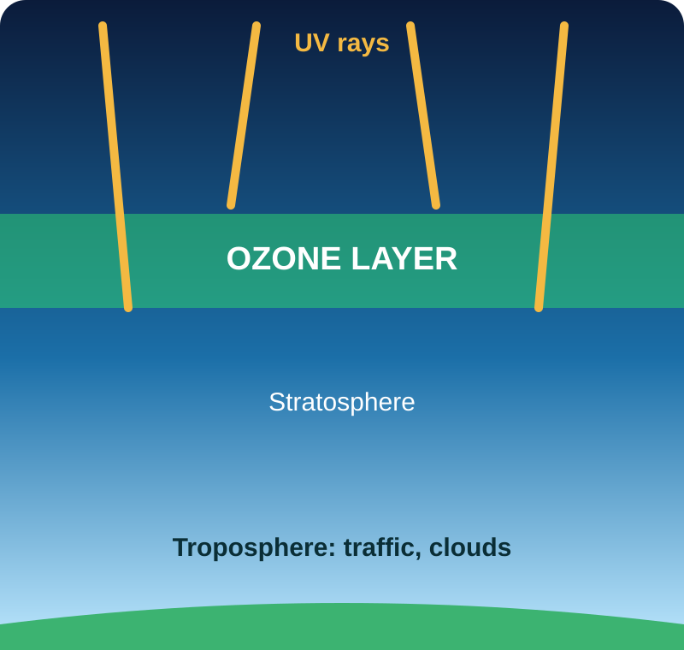



The ozone layer: our UV shield
Absorbs harmful UV radiation from the sun
Healing slowly thanks to the Montreal Protocol
N₂O and NOₓ from fuel burning still add pressure

Slide 5



From tailpipe to atmosphere
Fuel is burned
CO₂, NOₓ, N₂O released
Warming and ozone stress
Less fuel = less harm
Break the chain at the first link: burn less fuel on every trip.

Slide 6


Navigation today vs GreenRoute AI
Typical maps
GreenRoute AI
Optimised mainly for speed
Optimised for lowest CO₂
Eco option limited to some regions
Eco route is the default
No reward for green choices
Rewards and tracking built in

Slide 7
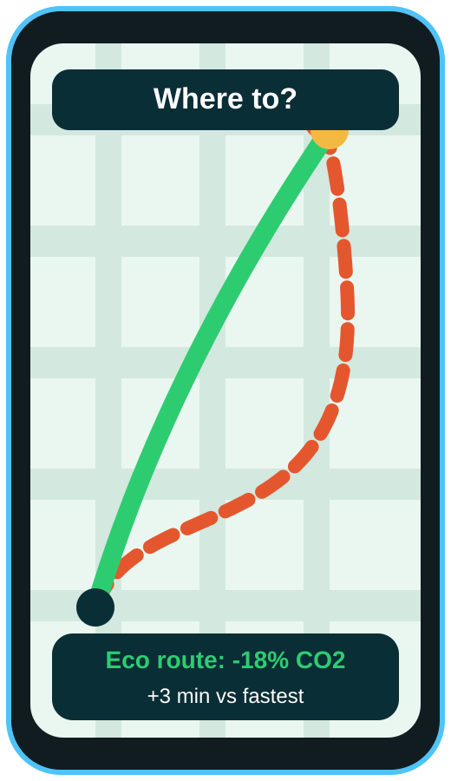



Eco-first navigation
Works like Google Maps: type a destination
AI ranks every route by estimated CO₂
Smooth routes use less fuel
Save money and earn green rewards

Slide 8
Fast is good.
Clean is better.
One tap shows the cleanest way to get there.

Slide 9



How the AI works
1. Collect
2. Predict
3. Optimise
4. Adapt
Traffic, slopes, speed limits, weather, vehicle type
ML model estimates fuel use per road segment
Finds the route with the lowest total CO₂
Re-routes live and learns from every trip

Slide 10

Data that feeds the model
Live traffic
Road slope
Weather
Vehicle type
Speed limits
Map data

Slide 11
Same trip, different footprint
-21%
CO₂ vs the fastest route, for only a few minutes more. Example for one commute.

Slide 12
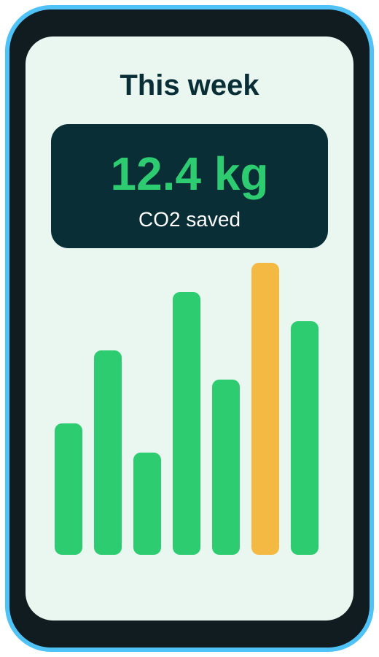

Inside the app
Eco route
Dashboard
Rewards
Compare fast vs green
See CO₂ saved
Earn points for green trips

Slide 13



Key features
Eco-Route
Vehicle profile
CO₂ dashboard
Lowest-carbon path, time trade-off shown
Petrol, diesel, hybrid or EV
Track kg of CO₂ saved weekly
Green rewards
Terrain aware
Community goals
Points redeemable with partners
Avoids steep climbs and jams
Cities and friends compete

Slide 14
Who will use it
Daily commuters
Delivery fleets
EV drivers
Eco travellers
Save fuel every day
Cut fuel bills and reports
Stretch every charge
Travel with a clear conscience

Slide 15

Market opportunity
All drivers
Everyone who drives is a potential user
Eco-minded drivers
Start with eco-minded drivers and fleets
First 100k
users
Launch in one city, then scale

Slide 16


How we make money
Premium app
Ad-free, advanced stats
Fleets & logistics
Cut fuel bills for companies
Green partners
Eco brands fund rewards
Carbon credits
Verified CO₂ savings sold

Slide 17
Pricing plans (example)
Premium
Free
Business
€2.99 / mo
€0
Custom
Advanced stats
Bonus rewards
No ads
Eco routes
Basic CO₂ stats
Fleet API
Carbon reports
Support

Slide 18
Growth outlook (illustrative)
Growth comes from fleets and partners once the user base is large.

Slide 19
Potential climate impact
~5%
less fuel per driver. Assumes about 4.6 t CO₂ per car per year.
Notes:
Estimate: 4.6 t x 5% = 0.23 t per user. To be validated in a pilot.

Slide 20
Two benefits, one app
Climate
Ozone layer
Less fuel burned
Lower CO₂ per trip
Slows warming
Less NOₓ and N₂O
Less pressure on the shield
Supports Montreal Protocol gains
Ozone recovery mainly depends on global agreements; we add a small, real contribution.

Slide 21
Why we can win
Feature | Typical maps | GreenRoute AI
Fastest route | Yes | Yes
Eco route | Limited, some regions | Core feature
Personal CO₂ dashboard | Not a focus | Yes
Rewards and community | No | Yes
Fleet carbon reports | No | Yes

Slide 22
Roadmap
Month 0-6
Month 6-12
Year 2
Year 3+
Build AI model & MVP
Pilot in one city
Launch fleet API
Go global

Slide 23

Risks and answers
Users want speed
Show the time trade-off, only a few minutes
Estimates must be accurate
Calibrate with real fuel data in the pilot
Big competitors
Focus on rewards, fleets and partners

Slide 24
Smarter roads,
cleaner planet
GreenRoute AI: profitable for us, good for drivers, great for the climate and the ozone layer.
Thank you! Questions?

